Slide 1
Tira Beauty
Under Guidance of Mrs. Vaishali Sonanis Mam.

Slide 2
Introduction :
Tira Beauty is a new online beauty retail platform under Reliance Retail, offering a seamless and personalized shopping experience with a curated selection of the best global and homegrown beauty brands
The brand aims to democratize beauty in India by breaking down barriers and becoming the leading inclusive beauty destination, focusing on accessible yet aspirational products for diverse consumer segments.

Slide 3
Members of Team
Mahender Reddy

Slide 4
Responsibilities
Assign the sub-module and tasks to the team member.
Review the test cases
Execute all the test cases.
Create defect report.

Slide 5
Overview
What is tirabeauty?
Founded in 2023, by isha ambani.
Tira Beauty is an online platform dedicated to beauty and wellness products, allowing users to explore a diverse range of products related to skin, hair, fragrance, men, bath & body, mom & baby, wellness, and personal care.
To perform testing using testng frame work and selenium, java etc. and solve the bugs and find the defects.

Slide 6
Modules
Module 1 : skin
Verified all features on the Skin page including product descriptions, quantity selection, filters, sets and bundles products, detailed product info, and both grid and list views.
Module 2 : hair
Tested all components on the Hair page such as item specifics, quantity controls, filtering options, detailed product information, and shop by concerns related hair.
Module 3 : Fragrance
Evaluated the Fragrance page functionality by checking product details, quantity adjustment, available filters, types of fragrances, product descriptions, and layout too.
Notes:
Module 1: Signn in page
Checked all the functionalities on Sign in page which included personal info as email
address, password
Module 2: Women page
Checked all the functionalities on Women page which included item details, Quantity, Filters,compare button,Add to cart button,product info,grid,list button
Module 3: Tshirt page
Checked all the functionalities on T-Shirt page which included item details, Quantity, Filters,compare button,Add to cart button,product info,grid,list button
Module 4: All Buttons and Drop Down Arrow :
team checked if all the buttons and drop down arrows of different fields are functioning properly or not

Slide 7
Module 4 : men
Checked the Men section for all interactive elements including item information, quantity input, filtering capabilities, budget buys, and grid/list display modes.
Module 5 : search
gives the related items which are being gave as input and also with partial text we can search items based on the need etc. also gives related product suggestion based on the search.
Module 6 : add to cart and delete
tested the add to cart button and remove button by adding max and min elements.
And some functions were functioning medium.
Module 7 : personal details
Tested the Personal Details section ensuring form fields, input validation, save and edit capabilities, update confirmations, and proper data handling were functioning as expected. Verified all the clickable and non clickable terms.

Slide 8
Defects
While running a testcase at certain point some fields are not working as it is expected which is nothing but a defect, so team have created a Defect report on those defects.
Found 2 defects which are displayed in post the page.

Slide 9
Defect identifier :- B_001
Defect summary :- gmail in profile part is not directed towards the email page or site.
Ø Test Id :- TC_020
Ø Test case name :- TC_information_gmail_uncilikable
Ø Module name :- personal details
Ø Reproducible :-
Ø Severity :- high
Ø Priority :- high
Ø Raised by :- Team member
Ø Assigned to :- developer Team lead
Ø Date of assignment :-
Ø Status :- pending
Ø Snap shots :-
Ø Fixed by :- developer
Ø Date of fixing :-

Slide 10
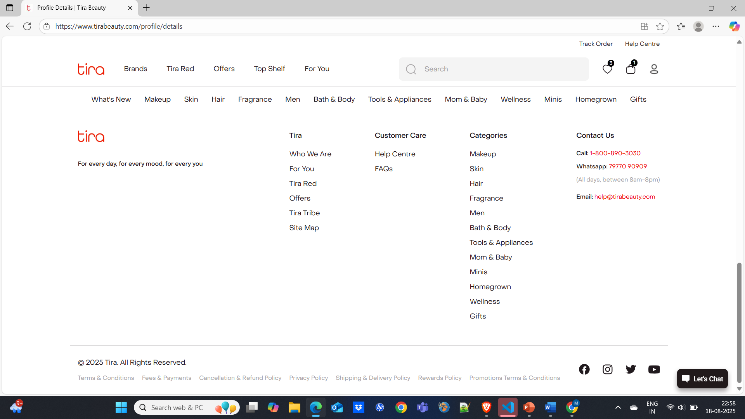


Slide 11
Defect identifier :- B_002
Ø Defect summary :- products are not displayed according their respective filters and no order.
Ø Test Id :- TC_007
Ø Test case name :- TC_assiginment order (any order)
Ø Module name :- most of modules
Ø Reproducible :-
Ø Severity :- high
Ø Priority :- medium
Ø Raised by :- Team member
Ø Assigned to :- developer Team lead
Ø Date of assignment :-
Ø Status :- pending
Ø Snap shots :-
Ø Fixed by :- developer
Ø Date of fixing :-

Slide 12
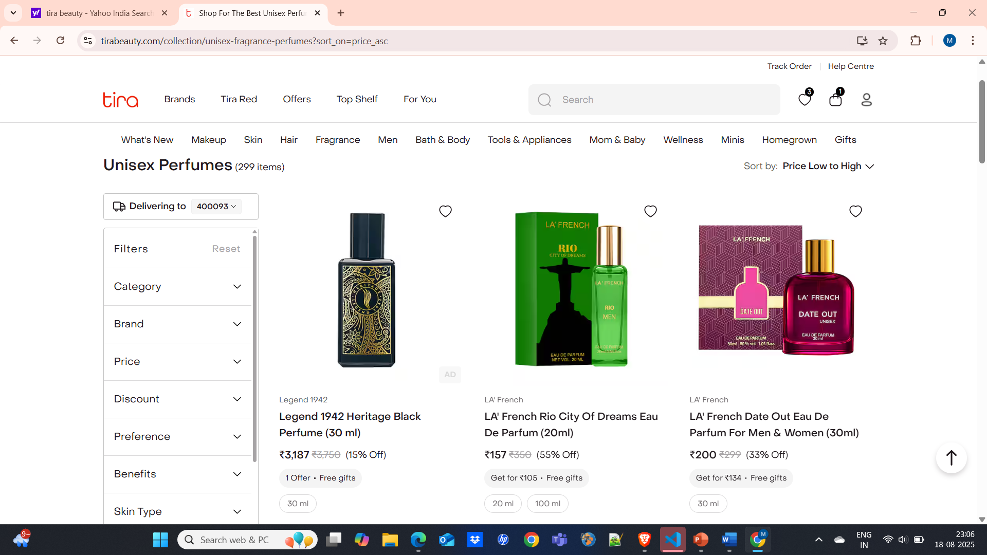




Slide 13
Challenges
While testing big website which contains huge data we faced some challenges about:
There is comes difference in writing a test case and while running it.
Interacting with elements before ready due to asynchronous loading.
Unstable tests due to timing or locator failures.
No active support for mobile applications.
Notifications (email) delivery after registering.

Slide 14
Experience
Help to find out bugs.
Helps us test products manually in module wise.
Can get better understanding in sdlc methodologies like agile in which project is divided in iterators and sprints.
By using jira tool we know when to update the project in time and what the bug is.
Performed cross platform testing etc.
Performed many inbuilt methods which makes testing ease and fast.

Slide 15
Thank You!!!
Vaishali Mam For Guiding Us through out the Project.

